Slide 1
IDEA/APPROACH DETAILS-SIH 2020
Ministry/Organization name : Ministry of Women and Child Development
Problem statement : BOOK-KEEPING AND ACCOUNTING SOFTWARE FOR IMO’S
PROBLEM CODE : AS34
TEAM NAME : BUG SLAYERS
TEAM LEADER NAME : LAGAN KAPOOR
COLLEGE CODE : 1-3516157399
College name : Rajalakshmi Institute of Technology

Slide 2
IDEA/SOLUTION/PROTOTYPE
When an Self Help Group needs loan, first they should have registered with any NGO’s. if it is not registered , our software provides us the user registration.
While registering the self help groups are provided with unique account id.
Using this account id, the self help groups will be verified and loan is provided
The duty of Rashtriya Mahila Kosh is to provide loan and access transaction details.
Finally, we will be calculating profit/loss using interest paid to Rashtriya Mahila Kosh and interest received by self help groups.
Profit/loss = interest received – interest paid.

Slide 3
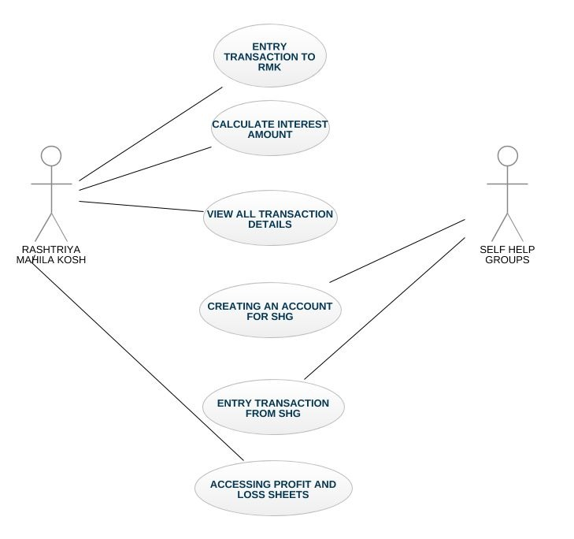
USE CASE DIAGRAM

Slide 4
TECHNOLOGY STACK
NETBEANS : CREATING VARIOUS JFRAMES AND JPANELS
MICROSOFT ACCESS : USED FOR STORING DATABASE VALUES THROUGH JDBC-ODBC CONNECTIVITY AND RS2XML JAR FILE COMPATIBILITY
SHOWSTOPPER
REQUIRES LARGE AMOUNT OF STORAGE SPACE TO STORE LARGE AMOUNT OF DATA

